Slide 1
An AI-Enabled Healthcare Platform for Unified Patient Data Management, Disease Prediction, and Personalized Treatment
The Tech Titans | CIEL Kingston vibeAIthon 2025

Slide 2
“Show. Don’t tell. Bring your idea to life!”

Slide 3
Problem Recap & Objective
Problem:
Patient healthcare data is fragmented across multiple hospitals and labs, leading to difficulty in unified access, redundant tests, and delayed diagnosis.
Objective:
To design a web-based healthcare application that predicts diseases based on symptoms and provides descriptions, medications, and precautionary advice using machine learning.
Expected Outcomes:
Centralized patient record handling system
Disease prediction with over 95% accuracy
Reduced diagnostic time and improved treatment awareness

Slide 4
Prototype Overview
A patient–doctor–hospital platform with disease prediction powered by a Random Forest ML model trained on symptom datasets. Users can log in, upload medical documents, view predictions, and exchange messages within a secure interface.
Technology Stack / Tools:
Frontend: HTML, CSS, JavaScript
Backend: Flask (Python)
Database: SQLite
ML Model: Random Forest (scikit-learn)
Additional Libraries: NumPy, Pandas, FuzzyWuzzy
Prototype Type: Functional (Web-based, Flask application)

Slide 5
User Experience & Impact
User Journey:
Patient logs in and enters symptoms.
Backend ML model predicts disease.
The system displays disease description, precautions, medications, and workout plans.
Doctors and hospitals can access relevant patient data and communicate.
Key Features:
Role-based login (Patient/Doctor/Hospital)
Disease prediction via trained ML model
Secure document upload & storage
Doctor–patient messaging system
Impact:
Simplifies early disease detection.
Enhances coordination between doctors, patients, and hospitals.
Promotes digital healthcare record management.
Next Steps:
Implement federated learning and privacy settings.
Deploy on cloud (AWS/GCP).
Conduct trials with real anonymized data for validation.

Slide 6
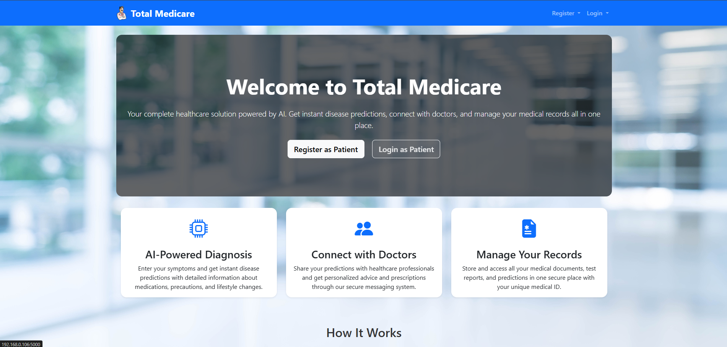
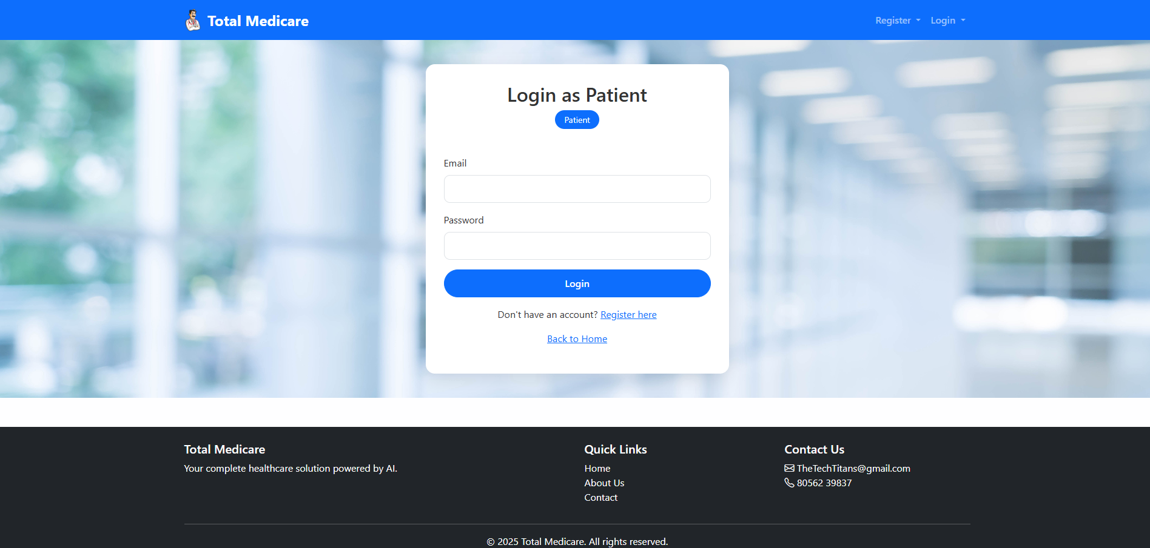
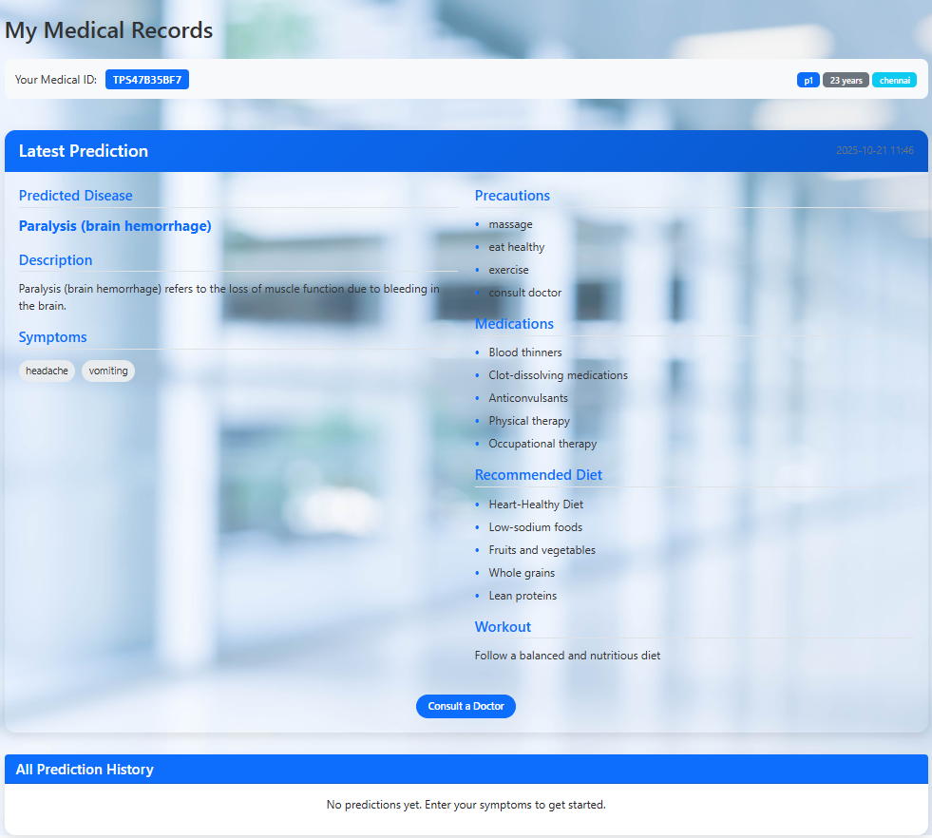
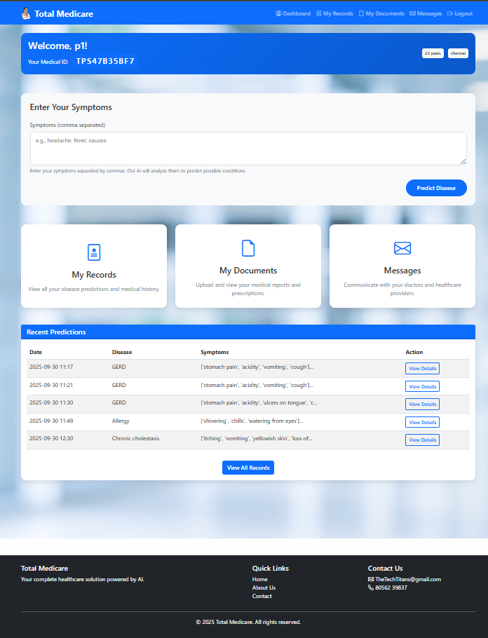
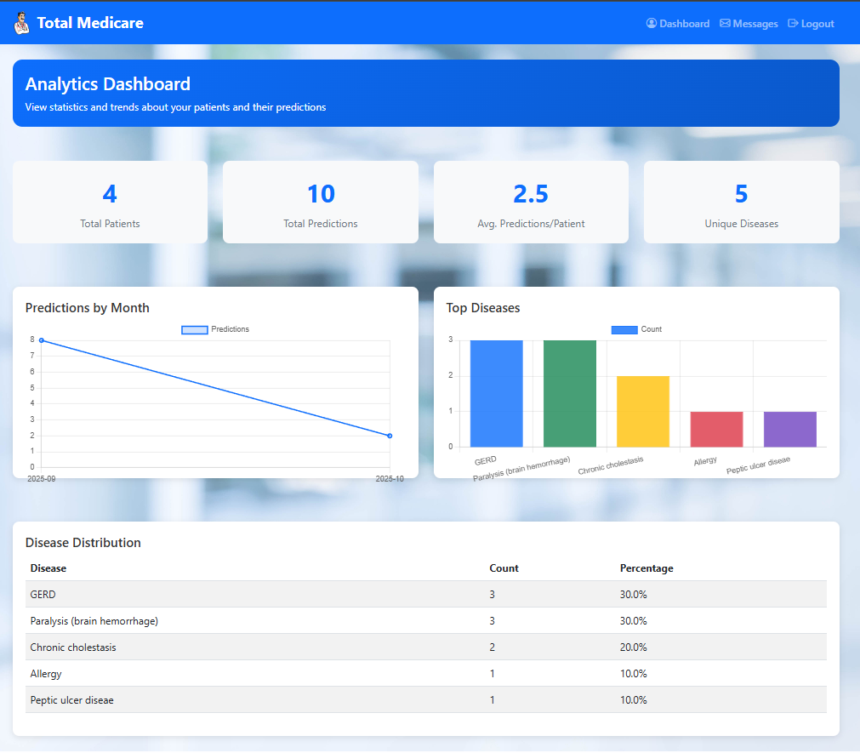
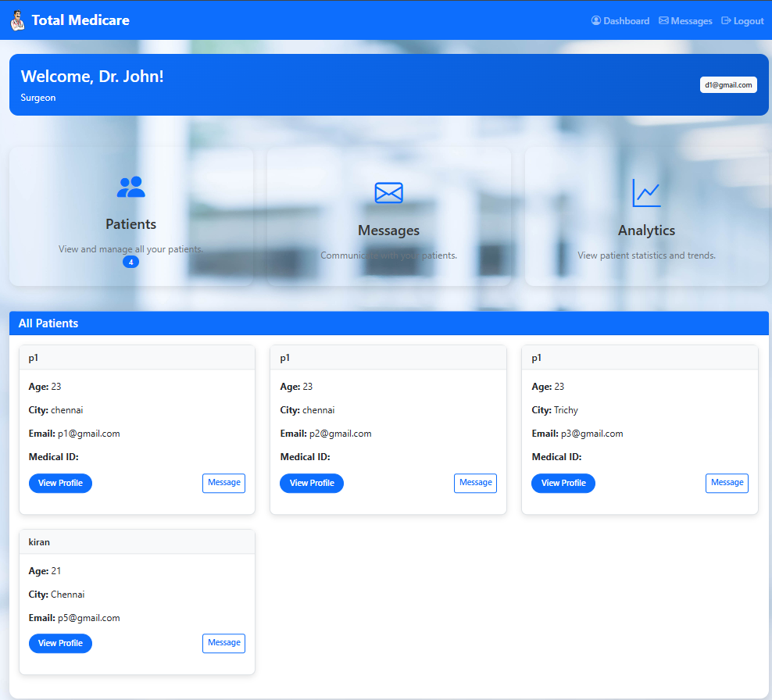
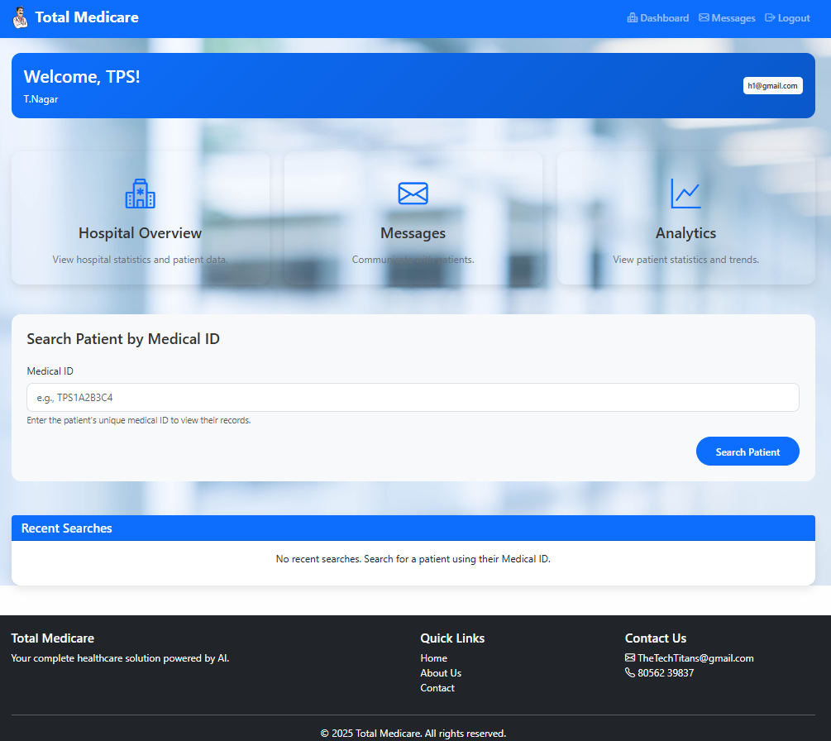
Screenshots

Slide 7
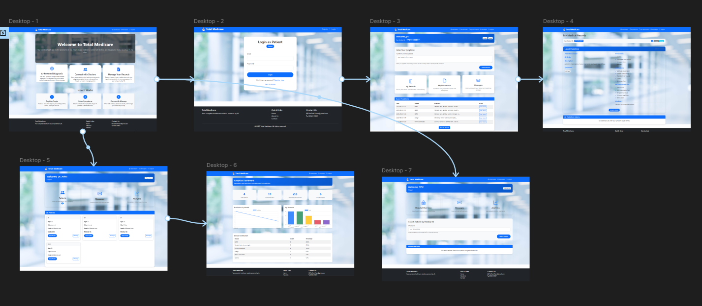
Wireframes

